Slide 1
Intro to R
R Workshop
January 18, 2021 Prepared by Jay Cao / TDMDAL
Website: https://tdmdal.github.io/r-intro-rbac-2021-winter/

Slide 2
Plan for Today (~2 hrs)
Intro to Intro
What’s R
Why learn R
Setup R
Three motivation examples
Basics of R language
Walk-through of a typical analysis workflow

Slide 3


What’s R?
R = a language + an eco-system
A free and open source programming language
An eco-system of many high-quality user-contributed libraries/packages
In the past, R is mostly known for its statistical analysis toolkits
Nowadays R is capable of (and very good at) many other tasks
Tools that cover the whole data analysis pipeline
Tools for web tech…

Slide 4
What’s R?
General purpose languages
- Python
- C/C++
Statistical Analysis Toolkits / Languages
- JMP
- SPSS
- Stata
Business Analytics Toolkits
- Tableau
- Power BI
- Excel

Slide 5
What can R do – Statistics & related
Statistics & Econometrics
Regressions
Time series analysis
Bayesian inference
Survival analysis
…
Numerical Mathematics
Optimization
Solver
Differential equations
…
Finance
Portfolio management
Risk management
Option pricing
…
…

Slide 6
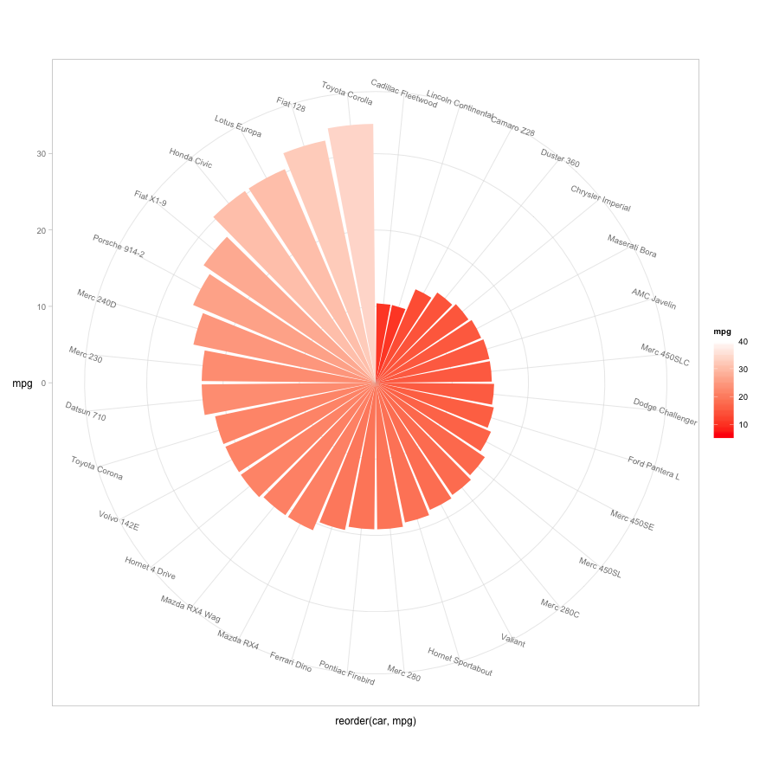
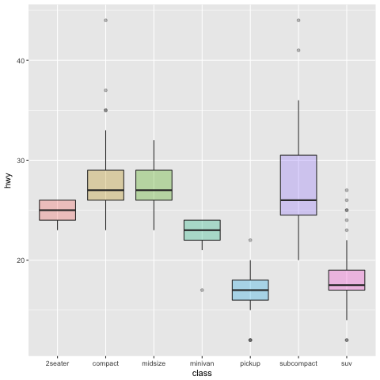
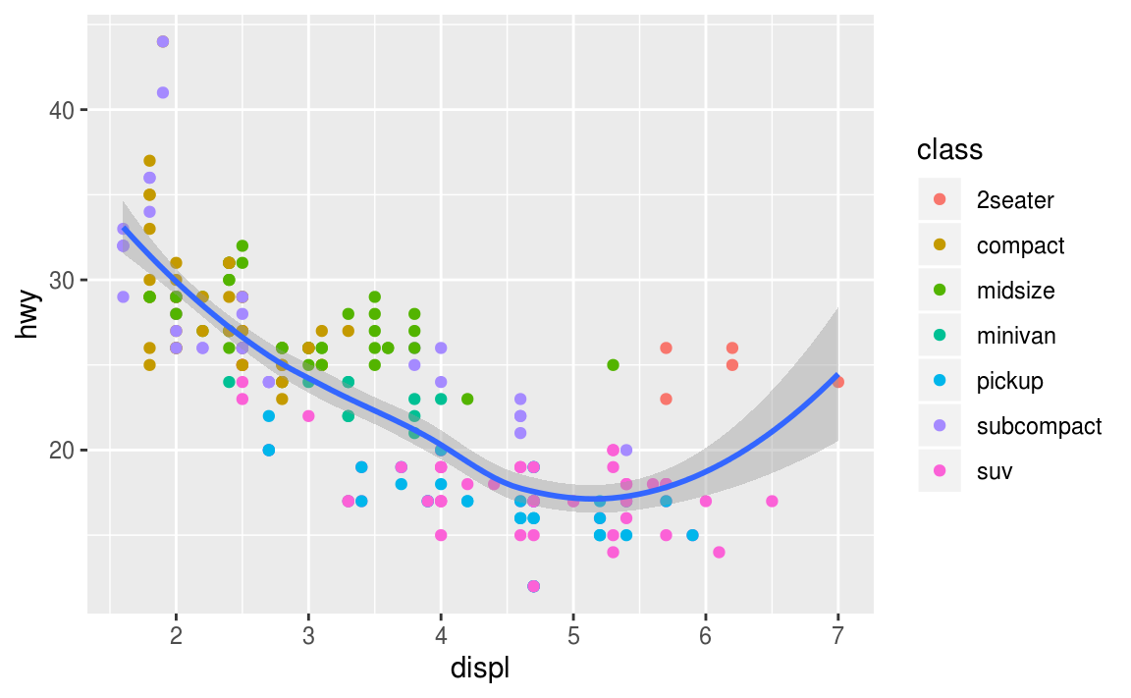
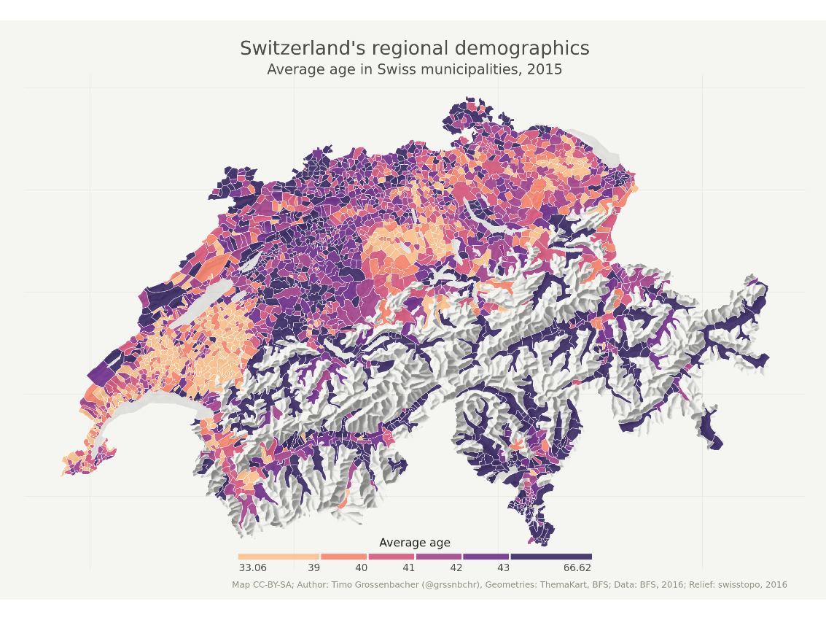
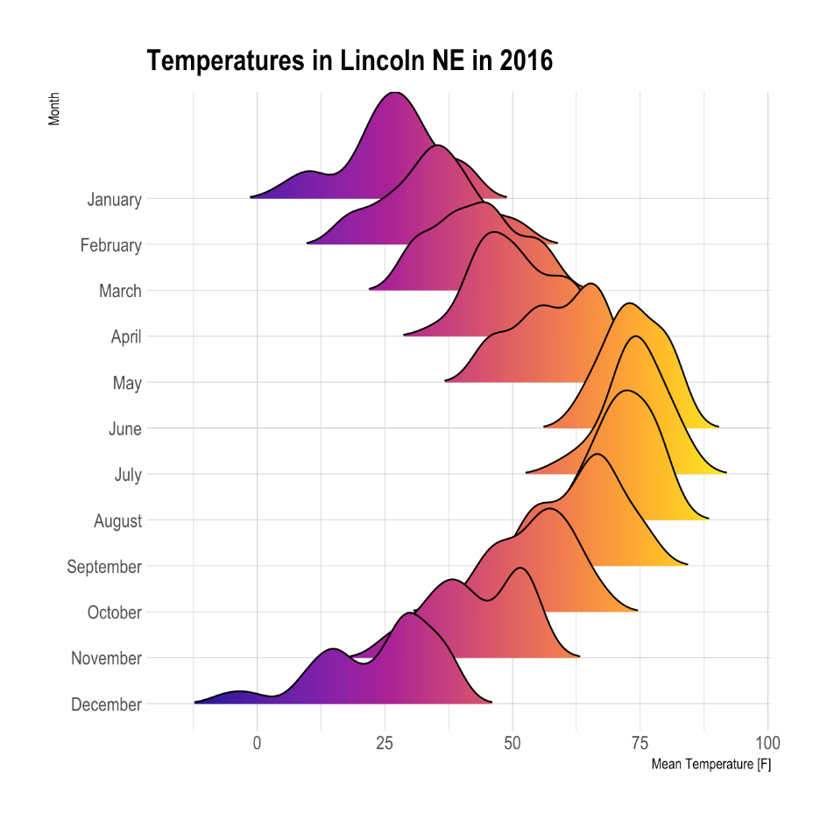
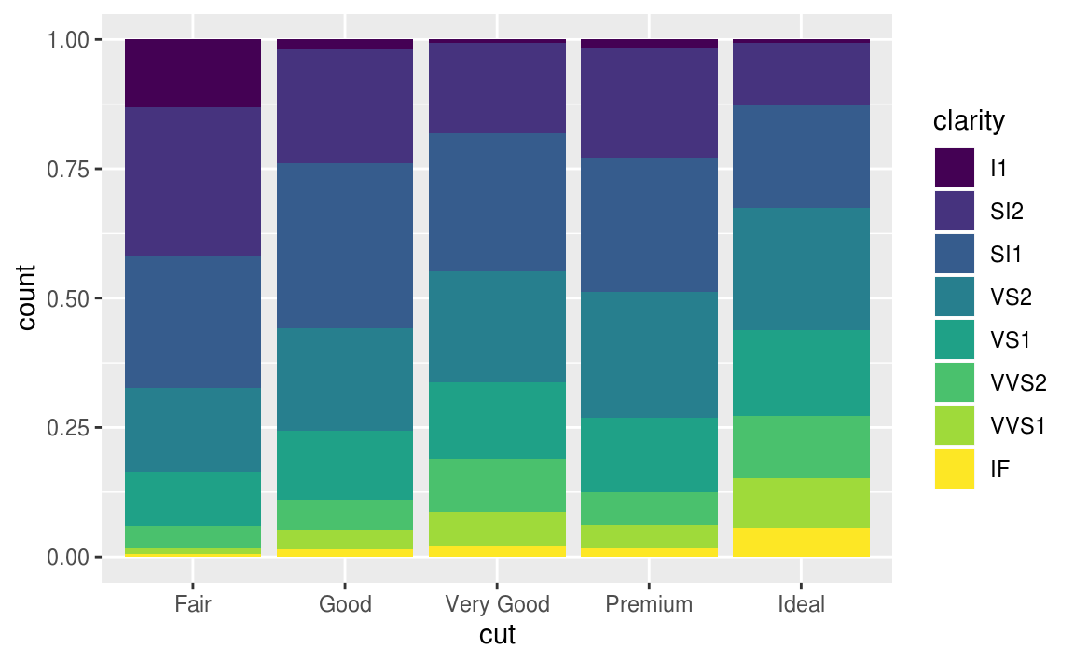
What can R do – Graphics (static ones)
…
https://www.r-graph-gallery.com/
https://timogrossenbacher.ch/2016/12/beautiful-thematic-maps-with-ggplot2-only/;

Slide 7
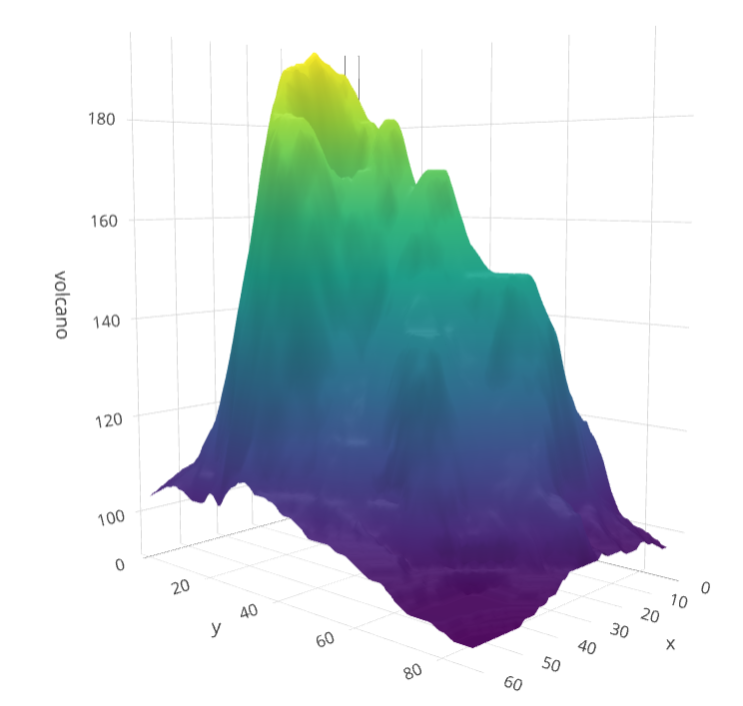
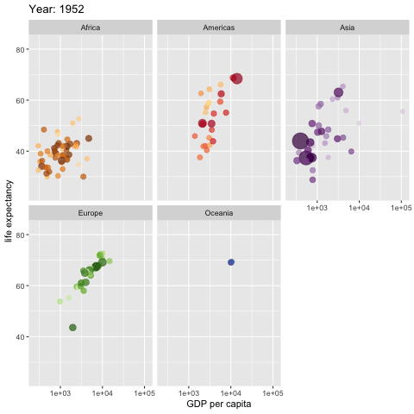
What can R do – Graphics (dynamic ones)
https://plot.ly/r/3d-surface-plots/; https://github.com/thomasp85/gganimate;

Slide 8
What can R do – Others
Machine learning (e.g. interface to Keras and Tensorflow)
Natural language processing (ex. tidytext, topicmodels)
Web technology
Web scraping (ex. rvest)
API wrapper (ex. Twitter: rtweet; bigquery: bigrquery; Quandl: Quandl)
Shiny web app (https://shiny.rstudio.com/)
Reporting
R Markdown (write reports, slides, blogs, books, etc. See a gallery here.)
… (see R Task View for more)

Slide 9
Why learn R (What can R do for You)?
Beyond Excel Data Analysis
I wish Excel could…
Automate boring repeating tasks
e.g. collecting data from different sources daily
Prototype ideas
e.g. trading strategy
…

Slide 10
Setup R
R on your computer
Install R (https://www.r-project.org/)
Install RStudio (https://rstudio.com/products/rstudio/download/)
R in Cloud (run R without installation)
RStudio Cloud (https://rstudio.cloud/)
Google Colab (https://colab.to/r)

Slide 11

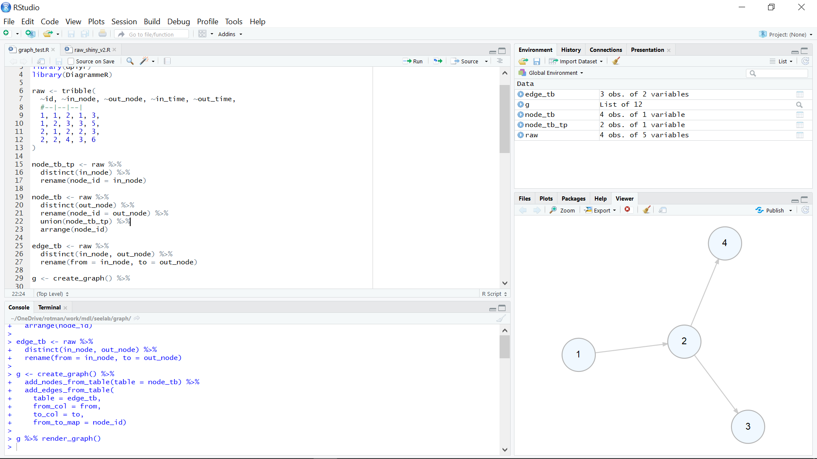
What’s RStudio?

Slide 12
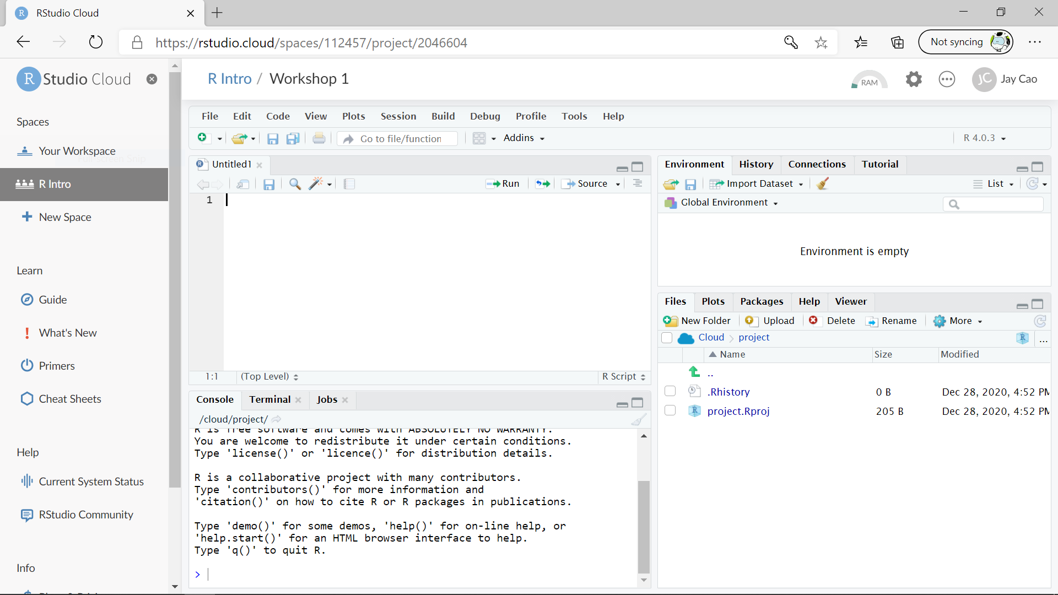
RStudio Cloud

Slide 13

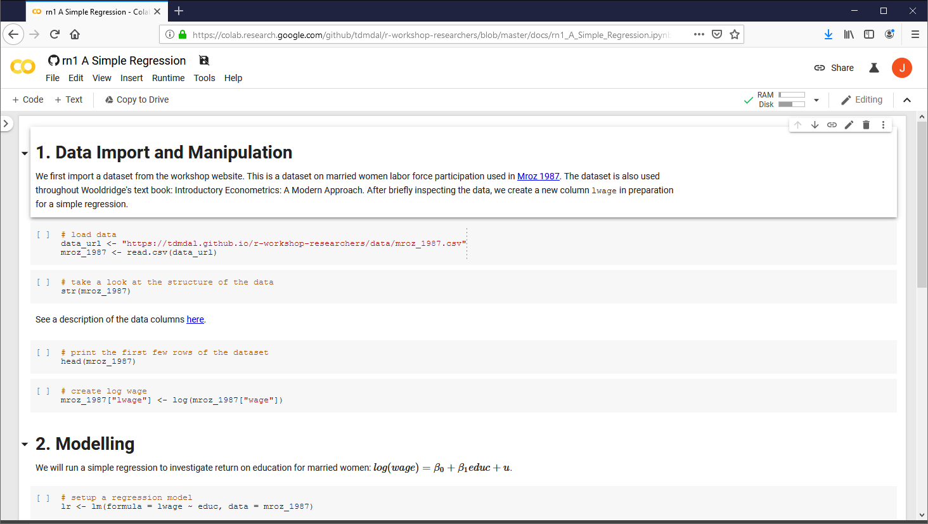
Google Colab

Slide 14





Data Analysis Workflow: Three Examples
A simple regression
Twitter API
Deep learning “Hello World!”
https://r4ds.had.co.nz/introduction.html

Slide 15
Plan for Today
Intro to Intro
Basics of R language (minimum to get us started today)
Expressions and assignment
Data structure
Programming structure (see appendix for more)
Walk-through of a typical analysis workflow

Slide 16
Expression and Assignment
# expression
2 + sqrt(4) + log(exp(2)) + 2^2
# assignment
x <- 3
y <- (pi == 3.14)

Slide 17
R Data Structure - Overview
 | Homogeneous | Heterogeneous
1-d | Atomic vector | List
2-d | Matrix | Data frame
n-d | Array
http://adv-r.had.co.nz/Data-structures.html

Slide 18
R Data Structure - Overview
 | Homogeneous | Heterogeneous
1-d | Atomic vector | List
2-d | Matrix | Data frame
n-d | Array
http://adv-r.had.co.nz/Data-structures.html

Slide 19
Atomic Vectors
# create R vectors
vec_character <- c("Hello,", "World!")
vec_integer <- c(1L, 2L, 3L)
vec_double <- c(1.1, 2.2, 3.3)
vec_logical <- c(TRUE, TRUE, FALSE)
Hello, | World!
1 | 2 | 3
1.1 | 2.2 | 3.3
TRUE | TRUE | FALSE

Slide 20
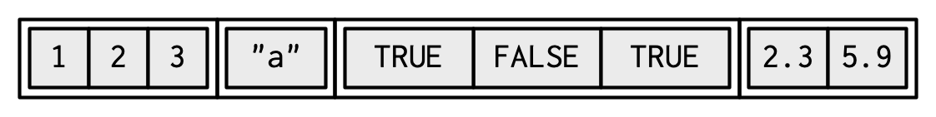
List
# create an R list
l1 <- list(
1:3,
"a",
c(TRUE, FALSE, TRUE),
c(2.3, 5.9)
)
ref. https://adv-r.hadley.nz/vectors-chap.html#list-creating

Slide 21
Data Frame
# create a data frame
df1 <- data.frame(
x = 1:3,
y = letters[1:3],
z = c(1.1, 2.2, 3.3)
)
x | y | z
1 | "a" | 1.1
2 | "b" | 2.2
3 | "c" | 3.3

Slide 22
Data Frame
# create a data frame
df1 <- data.frame(
x = 1:3,
y = letters[1:3],
z = c(1.1, 2.2, 3.3)
)
x | y | z
1 | "a" | 1.1
2 | "b" | 2.2
3 | "c" | 3.3

Slide 23
Data Frame
# create a data frame
df1 <- data.frame(
x = 1:3,
y = letters[1:3],
z = c(1.1, 2.2, 3.3)
)
x | y | z
1 | "a" | 1.1
2 | "b" | 2.2
3 | "c" | 3.3

Slide 24
Tibble – A Cousin to Data Frame
# load tibble library (part of tidyverse lib)
library(tibble)
# create a tibble
tb1 <- tibble(
x = 1:3,
y = letters[1:3],
z = c(1.1, 2.2, 3.3)
)
x | y | z
1 | "a" | 1.1
2 | "b" | 2.2
3 | "c" | 3.3
https://r4ds.had.co.nz/tibbles.html#tibbles-vs.data.frame

Slide 25
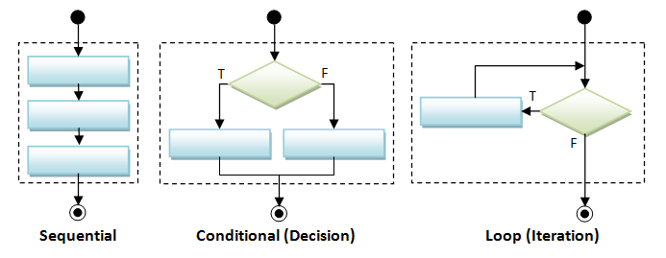
Programming Structure: Control Flows

Slide 26
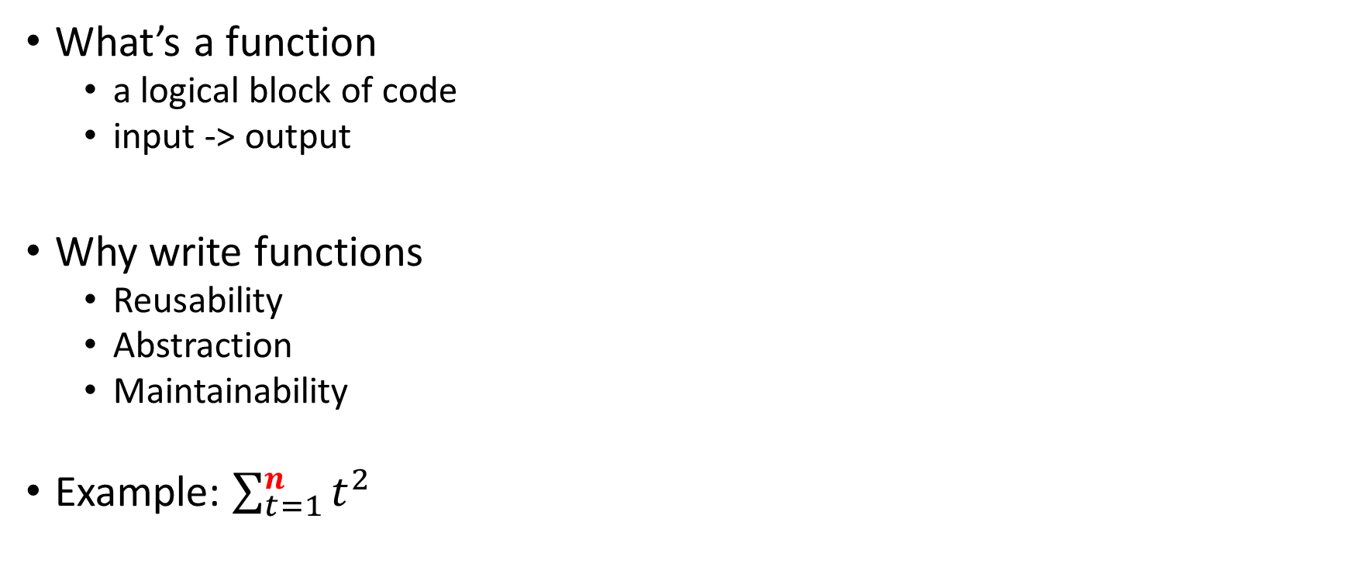
Programming Structure: Functions
# sum of squares from 1 to n
ss <- function(n) {
t <- 1:n
sum(t^2)
}
# calling the ss() function
print(ss(2))
print(ss(3))
What’s a function
a logical block of code
input -> output
Why write functions
Reusability
Abstraction
Maintainability
Example: $\sum_{t=1}^{n}{t^{2}}$

Slide 27
Plan for Today
Intro to Intro
Basics of R language
Walk-through of a typical analysis workflow
Import and manipulate data
Build models
Report results

Slide 28
Extending the regression example
Manipulate data
Load data
Create new columns
Filter columns and rows
Build models
Multiple linear regression
Regression with interactive terms
Report and graph
Build a publication-ready table for regression results

Slide 29
Using R libraries
Install and load an R library
install.packages("library_name")
library(library_name)
CRAN (The Comprehensive R Archive Network)
CRAN Task Views

Slide 30
Many choices, which one to use
Often time, many choices of functions/libraries to do one task
R is open and extensible!
Example: load a csv file to a data frame
Use read.csv() function from the utils library
Use read_csv() function from the readr library
Use fread() function from the data.table library
Use vroom() from the vroom library

Slide 31
Many choices, which one to use
Start with the one most people use
Choose one that is well maintained
check document, github, etc. for last update
Choose one that suits your task

Slide 32
Our Choice: extending the regression example
Manipulate data (tidyverse eco-system)
Load data (read_csv() from the readr)
Create new columns (mutate() from dplyr)
Filter columns and rows (select() and filter() from dplyr)
Build models
Multiple regression (lm() from stats library in R base)
Report and graph
Build a publication-ready table (huxreg() from huxtable library)

Slide 33
Load a CSV file
read_csv() from the readr
read_csv(file)
e.g. hprice <- read_csv("hprice.csv")
More about read_csv()
More about readr

Slide 34
Load Data – Many other libraries
readxl for Excel sheets
haven for SPSS, Stata and SAS data
jsonlite for JSON
xml2 for XML
httr for web APIs
rvest for web scraping
DBI for connecting to DataBase engine
…

Slide 35
Data Manipulation: dplyr basics
Filter observations: filter()
Select variables: select()
Reorder rows: arrange()
Create new variables: mutate()
Collapse column values to a single summary: summarise()
Group by: group_by()

Slide 36
Data Manipulation: filter()
filter(my_dataframe, condition1, …)
e.g.
hprice_reg <- filter(hprice, price > 20000)

Slide 37
Data Manipulation: mutate()
mutate(my_dataframe, new_var1 = expression1, …)
e.g.
hprice_reg <- mutate(hprice_reg, lprice = log(price))

Slide 38
Data Manipulation: select()
select(my_dataframe, var1, …)
e.g.
hprice_reg <- select(hprice_reg, lprice, rooms)

Slide 39
Data Manipulation: Data Pipe (%>%)
hprice_reg <- filter(hprice, price > 20000)
hprice_reg <- mutate(hprice_reg, lprice = log(price))
hprice_reg <- select(hprice_reg, lprice, rooms)

Slide 40
Data Manipulation: Data Pipe (%>%)
hprice_reg <- filter(hprice, price > 20000)
hprice_reg <- mutate(hprice_reg, lprice = log(price))
hprice_reg <- select(hprice_reg, lprice, rooms)
hprice_reg <- hprice %>%
filter(., price > 20000) %>%
mutate(., lprice = log(price)) %>%
select(., lprice, rooms)

Slide 41
Data Manipulation: Data Pipe (%>%)
hprice_reg <- filter(hprice, price > 20000)
hprice_reg <- mutate(hprice_reg, lprice = log(price))
hprice_reg <- select(hprice_reg, lprice, rooms)
hprice_reg <- hprice %>%
filter(price > 20000) %>%
mutate(lprice = log(price)) %>%
select(lprice, rooms)

Slide 42
Data Manipulation: Others
Join two data frames
_join() family in dplyr
Reshape data frames
pivot_longer() and pivot_wider() in tidyr

Slide 43
Regression
Multiple regressions: lm() from stats library in base R
my_model <- lm(y ~ x1 + x2, data)
Multiple regressions with interactive terms
my_model <- lm(y ~ x1 + x2 + I(x1 * x2), data)
Regression result summary: summary()
Ref. https://faculty.chicagobooth.edu/richard.hahn/teaching/FormulaNotation.pdf

Slide 44
Report
Summary table
Summary for lm(): summary(my_model)
publication-ready table: huxreg() from huxtable library
huxtable(my_model1, my_model2, …)
Ref. https://hughjonesd.github.io/huxtable/huxreg.html

Slide 45

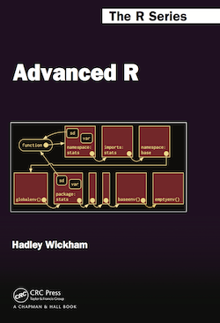
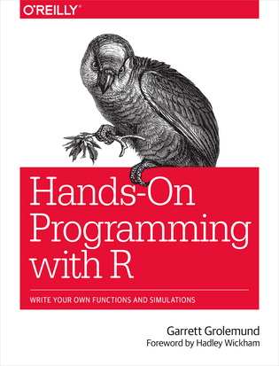
Free Learning Resources - Books
R for Data Science
Advanced R
Hands-On Programming with R
Check bookdown.org often

Slide 46
Free Learning Resources – Video Courses
RStudio Resources Site
Coursera
free for UofT students (also mostly free if you just audit the courses)
Search R and learn

Slide 47
Free Learning Resources – Others
RStudio Education (Choose Your Learning Paths)
CRAN Task View
Twitter (a few seeds: #rstat, @hadleywickham, @WeAreRLadies)

Slide 48
Plan for Today
Intro to Intro
Basics of R language
Walk-through of a typical analysis workflow
Appendix: more on programming structure

Slide 49
Programming Structure: Control Flows

Slide 50
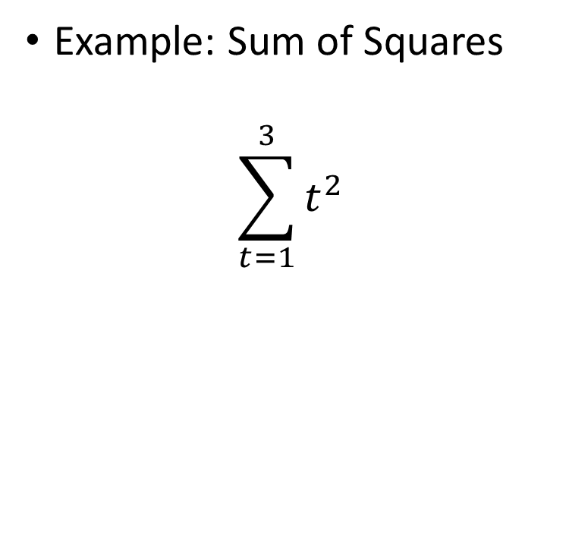
Sequential
Example: Sum of Squares
$$\sum_{t=1}^{3}{t^{2}}$$
# sum of squares
t <- 1:3
y <- sum(t^2)
print(y)

Slide 51
Sequential
Example: Sum of Squares
$$\sum_{t=1}^{3}{t^{2}}$$
# sum of squares
t <- 1:3
y <- sum(t^2)
print(y)
t
1 | 2 | 3

Slide 52
Sequential
Example: Sum of Squares
$$\sum_{t=1}^{3}{t^{2}}$$
# sum of squares
t <- 1:3
y <- sum(t^2)
print(y)
t
1 | 2 | 3
t^2
1 | 4 | 9
sum(t^2)
14

Slide 53
Conditional (if…else…)
if (cond) {
# run here if cond is TRUE
} else {
# run here if cond is FALSE
}
# y greater than 10?
if (y > 10) {
print("greater than 10")
} else {
print("less or equal to 10")
}

Slide 54
Conditional (if…else…)
if (cond) {
# run here if cond is TRUE
} else {
# run here if cond is FALSE
}
# y greater than 10?
if (y > 10) {
print("greater than 10")
} else {
print("less or equal to 10")
}
T
y>10?
F
“great…”
“less…”

Slide 55
Conditional (if…else if…else…)
if (cond1) {
# run here if cond1 is TRUE
} else if (cond2) {
# run here if cond1 is FALSE but cond2 is TRUE
} else {
# run here if neither cond1 nor cond2 is TRUE
}

Slide 56
Iteration
for (var in seq) {
do something
}
while (cond) {
do something if cond is TRUE
}
# sum of squares
t <- 1:3
y <- 0
for (x in t) {
y <- y + x^2
}
print(y)

Slide 57
Programming Structure: Functions
# sum of squares from 1 to n
ss <- function(n) {
t <- 1:n
sum(t^2)
}
# calling the ss() function
print(ss(2))
print(ss(3))
What’s a function
a logical block of code
input -> output
Why write functions
Reusability
Abstraction
Maintainability
Example: $\sum_{t=1}^{n}{t^{2}}$

Slide 58
Programming Structure: Functions
# sum of squares from 1 to n
ss <- function(n) {
t <- 1:n
sum(t^2)
}
# calling the ss() function
print(ss(2))
print(ss(3))
What’s a function
a logical block of code
input -> output
Why write functions
Reusability
Abstraction
Maintainability
Example: $\sum_{t=1}^{n}{t^{2}}$

Slide 59
Programming Structure: Functions
# sum of squares from 1 to n
ss <- function(n) {
t <- 1:n
sum(t^2) # return(sum(t^2))
}
# calling the ss() function
print(ss(2))
print(ss(3))
What’s a function
a logical block of code
input -> output
Why write functions
Reusability
Abstraction
Maintainability
Example: $\sum_{t=1}^{n}{t^{2}}$

